Slide 1

Project Title :Product Recommendation System
Team members: Kapil Varma Bommagani Harshitha Challa Naga Divya Manchineni Sireesha Avula

Slide 2

Product Recommendation System, recommends user relevant products chosen by them
It basically filters the items selected by the customer by seeking to predict and display the item
Motivation

Slide 3
Objective
When a customer searches for a product on an e-commerce website, it will be recommended the most popular products on the site that are related to it.

Slide 4
Models used
Here, we are using Deep learning technique, product suggestions are given to the customers in the application using CNN model

Slide 5
Work flow
Core Functionality
Image processing
2D features frameworks
Object detection

Slide 6
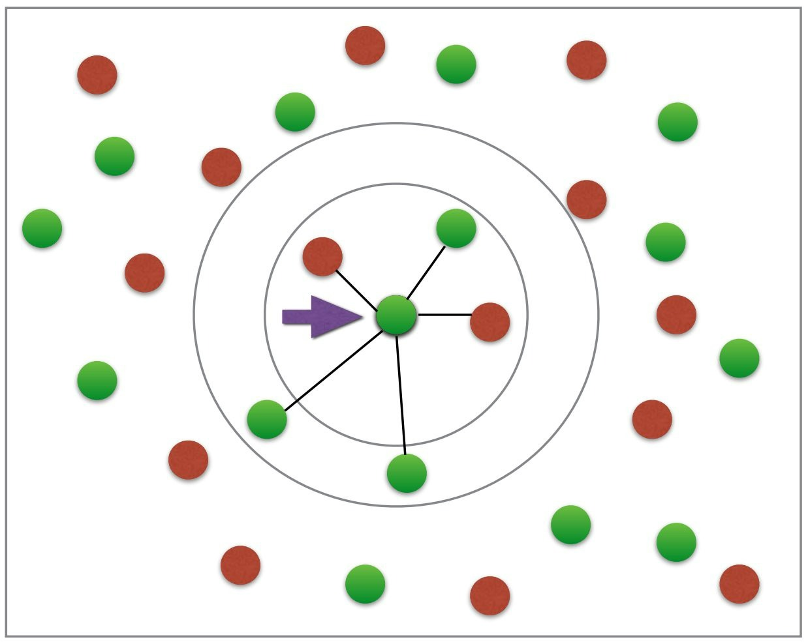
Nearest neighbors
Nearest Neighbors implements unsupervised nearest neighbors learning.
The number of samples can be a user-defined constant (k-nearest neighbor learning), or vary based on the local density of points (radius-based neighbor learning).

Slide 7

Torch framework
A GPU-Ready Tensor Library
Dynamic Neural Networks: Tape-Based Autograd

Slide 8

Torch.nn
The value a Sequential provides over manually calling a sequence of modules is that it allows treating the whole container as a single module, such that performing a transformation on the Sequential applies to each of the modules it stores.
A sequential container. Modules will be added to it in the order they are passed in the constructor. Alternatively, an OrderedDict of modules can be passed in. The forward() method of Sequential accepts any input and forwards it to the first module it contains. It then “chains” outputs to inputs sequentially for each subsequent module, finally returning the output of the last module.

Slide 9
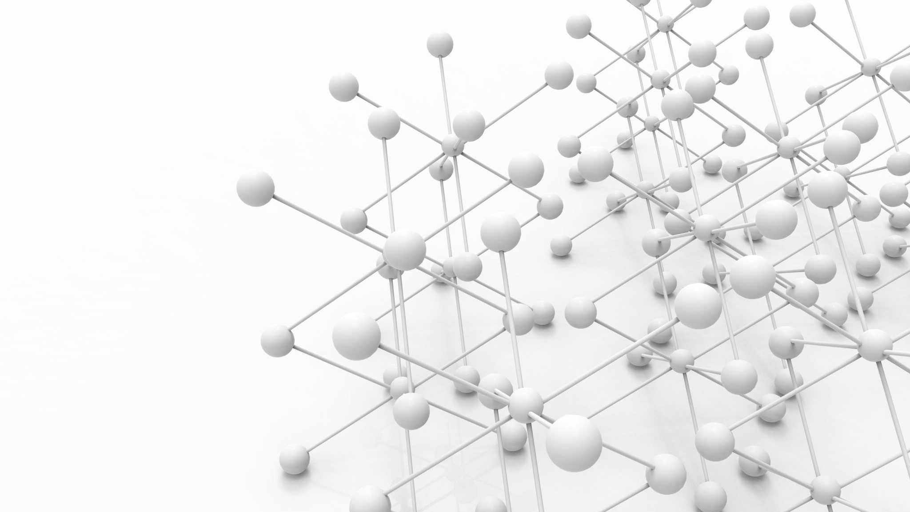
Torch Vision
The models subpackage contains definitions of models for addressing different tasks, including: image classification, pixelwise semantic segmentation, object detection, instance segmentation, person keypoint detection and video classification.
Transforms are common image transformations. They can be chained together using Compose. Most transform classes have a function equivalent: functional transforms give fine-grained control over the transformations. This is useful if you have to build a more complex transformation pipeline (e.g. in the case of segmentation tasks).

Slide 10

Torch.autograd
Torch.autograd provides classes and functions implementing automatic differentiation of arbitrary scalar valued functions.

Slide 11
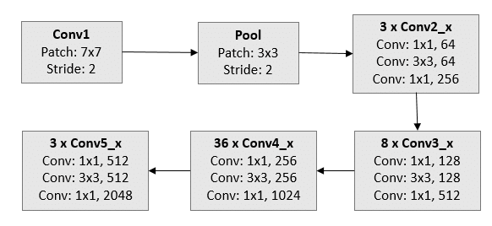
Resnet 152
Resnet introduces a structure called residual learning unit to alleviate the degradation of deep neural networks. This unit's structure is a feedforward network with a shortcut connection which adds new inputs into the network and generates new outputs. The main merit of this unit is that it produces better classification accuracy without increasing the complexity of the model. We select Resnet152 as it achieves the best accuracy among Resnet family members

Slide 12
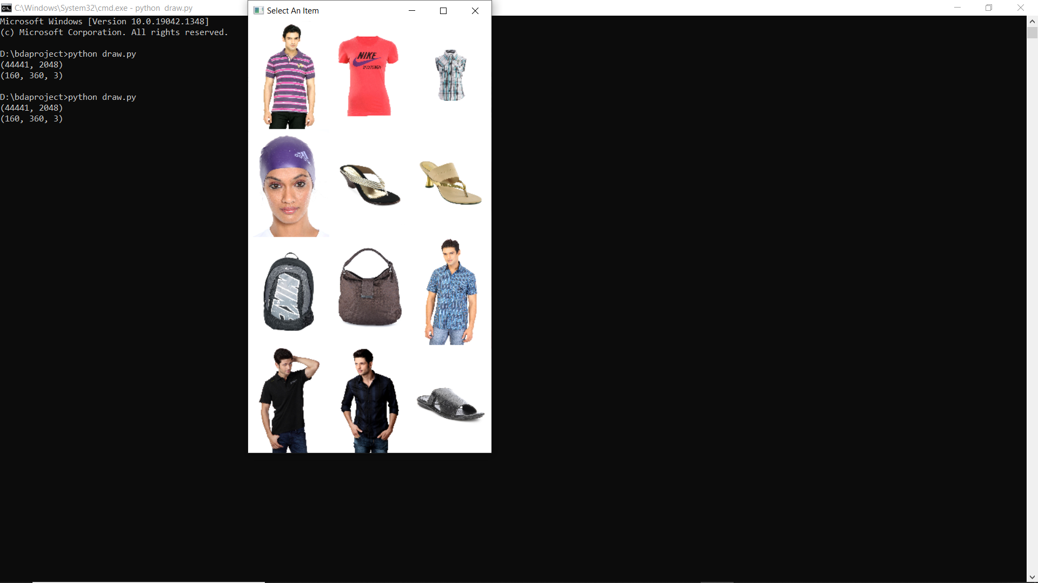
Project Screenshots

Slide 13
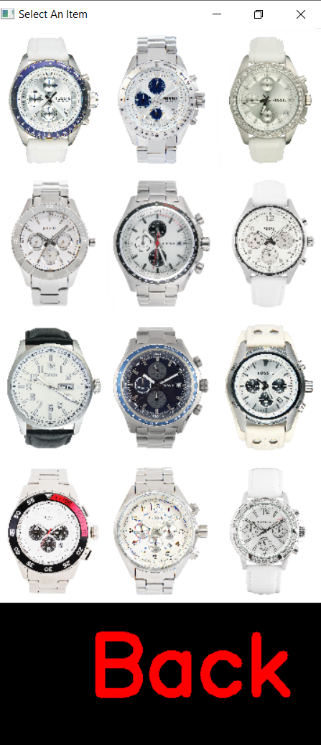

Slide 14
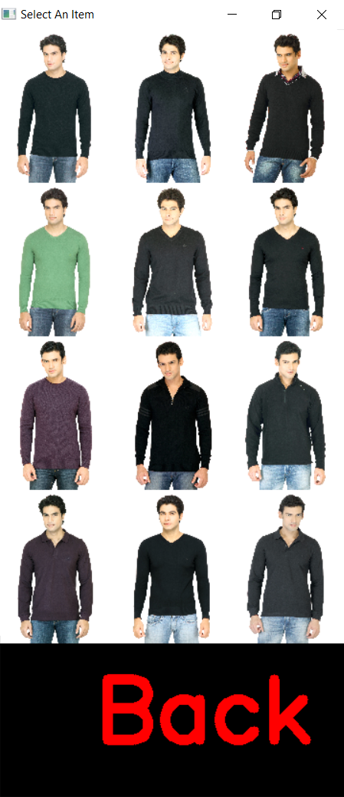

Slide 15
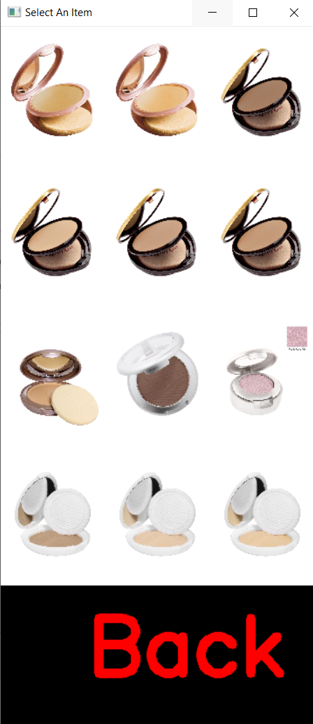

Slide 16
THANK YOU

